Slide 1
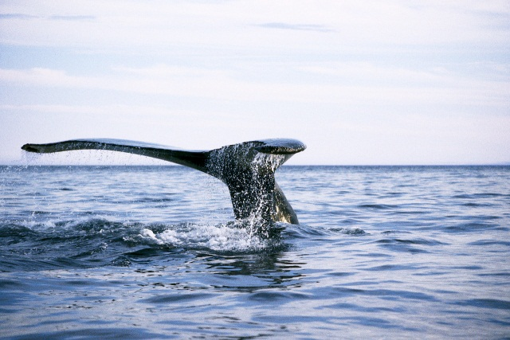
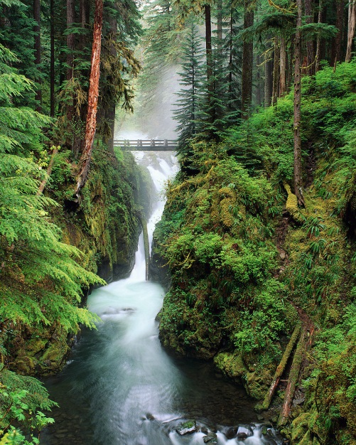
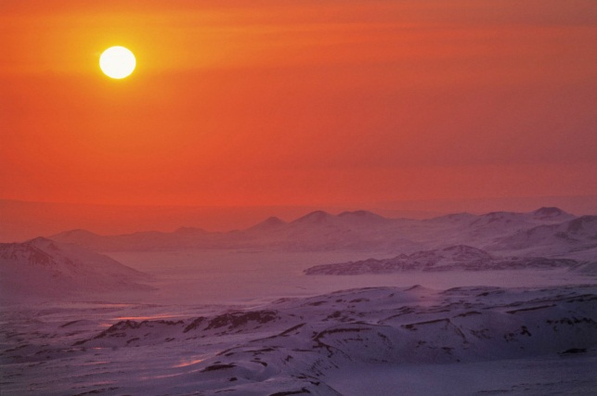
Ecosystems

Slide 2
What is an ecosystem?

Slide 3
An ecosystem, short for 'ecological system', includes all the living organisms existing together in a particular area, or community.

Slide 4
Remember…
...an organism is any living thing!
Now, name some organisms that YOU know!

Slide 5
Population
How does ‘population’ relate to an ecosystem? Support your answer with an example!
A population is a group of organisms that are the same species living together in a community.

Slide 6
Producers, Consumers and Decomposers
Within an ecosystem we have producers, consumers, and decomposers. Explain what each of these roles are, and support your answer with examples!

Slide 7
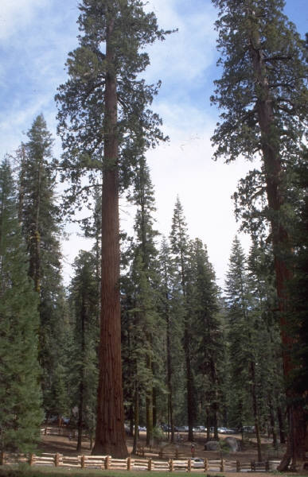
Producers
Producers use the energy from the sun to produce their own food! Examples of producers include bushes, trees, flowers, and shrubs.

Slide 8
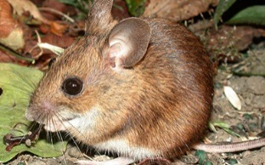
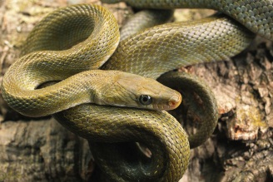
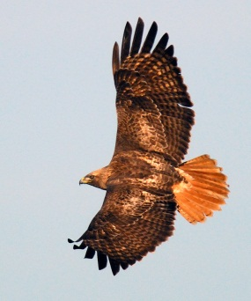
Consumers
Consumers must consume food for energy! There are a few kinds of consumers. They are:
-Primary Consumer: These consumers eat the producers. Primary consumers are herbivores. (Ex: a field mouse)
-Secondary Consumer: These consumers eat primary consumers. Secondary Consumers are carnivores. (Ex: a snake)
-Tertiary Consumer: These consumers eat the secondary consumers. Tertiary consumers are usually the predators within an ecosystem (and primary and secondary consumers are usually considered the prey). (Ex: a hawk)

Slide 9
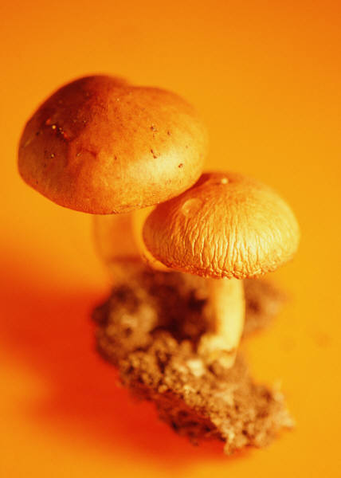
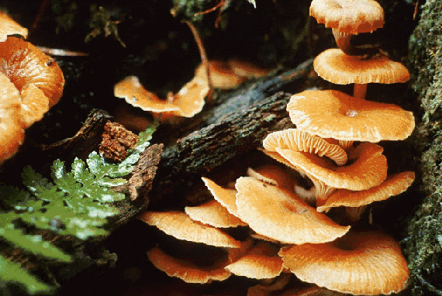
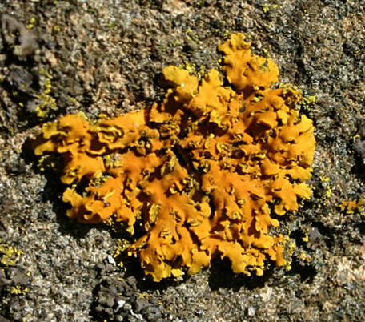
Decomposers
Decomposers break down waste and dead animals and return the nutrients back into the earth. Examples of decomposers include mushrooms, fungi, and lichen (found in the tundra ecosystem!)

Slide 10
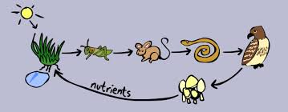
Food Chain
Let’s play the food chain game!
http://www.sheppardsoftware.com/content/animals/kidscorner/games/foodchaingame.htm

Slide 11
Energy Transfer
Explain the energy transfer rule. How much energy does an organism acquire from its food?
Food chains show how energy moves through an ecosystem. When an organism eats, the organism only gets 10% of the energy from its food. For example, if a snake ate a field mouse, the snake would only get 10% of the energy from the field mouse.

Slide 12
Energy Transfer
We can also show the transfer of energy using an energy pyramid. Where would we place the following on the energy pyramid?
Tertiary consumer
producer secondary consumer
tertiary consumer primary consumer
Secondary consumer
Primary consumer
Why are there fewer tertiary consumers within an ecosystem?
producer

